Slide 1

Internet Banking System
Instructor name - Dr. Jun Wang
CS 5610 Group Project – Introduction to Cloud Computing

Slide 2

Overview
Focus on online transactions, accounts, and analytics.
Admin panel and customer panel for management.
Customers can register, apply for banking accounts, and update profiles.
Finance section includes deposits, withdrawals, transfers, and balance inquiries.
Transaction history and financial reports track all activities.

Slide 3
Customer Panel Features:
Customers can apply for bank accounts with automatic account number generation.
Multiple bank accounts per customer supported.
Customers have individual dashboards with records and analytics.
Update profiles and passwords.
Finance Section:
Four categories: Deposits, Withdrawals, Transfers, and Balance inquiries.
Simple deposit and withdrawal procedures.
Easy money transfers to other accounts.
Check overall balance and activities.

Slide 4
Transaction History and Financial Reports:
Detailed transaction history with transaction codes, account numbers, types, amounts, and timestamps.
Financial reports for withdrawals, deposits, and transfers with search function.
Admin Panel:
Full control for administrators.
Manage customers, users, products, and more.
View overview figures and advanced analytics with pie charts.
Check latest transactions.

Slide 5
Staff and Client Management:
Admin can manage staff and client members.
Simple registration process for staff with login details.
Client registration with login details and profile picture.
Accounts Section:
Admin can add and manage account types.
Account types have names, rates per year, and descriptions.
Search functionality available for quick record finding.

Slide 6
Notification and Finance:
Admin receives notifications for ongoing system transactions and activities.
Finance section allows completing transactions like teller services.
Staff Panel:
Staff can view overall transactions, deposits, withdrawals, transfers, and bank accounts.
Manage client members, bank accounts, and finances.
View account holders' transaction history and financial reports.
Receive system activity notifications.

Slide 7
Available Features
Admin Panel
Staff Panel
Customer Panel
Account Management
Deposit/Withdraw Amount
Transfer Amount
Transaction History
Activity Notifications
Check Account Balance
Print Account Balance
Deposit Report
Withdrawal Report
Transfer Report
View Overall Wallet Balance
View Analytics
Staff Management
Customer Management
System Settings

Slide 8
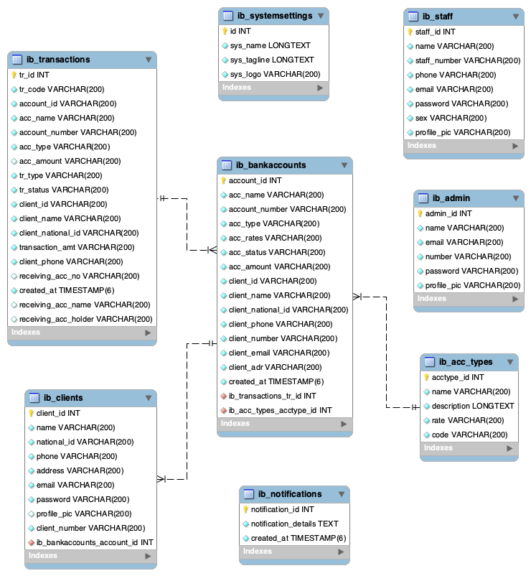
ERD (Entity-Relationship Diagram)
Clients: Store customer information (client_id, name, email, contact).
Bank Accounts: Manage bank accounts (account_id, account_number, balance).
Account Types: Define different types of bank accounts (account_type_id, account_type_name).
Transactions: Record transaction details (transaction_id, transaction_date, amount, description).

Slide 9

Deployment on AWS
AWS Services Used:
Amazon RDS: Store data in MySQL database.
Amazon EC2: Host the PHP application.
Elastic IP: Allocate a static public IP address to the EC2 instance.
Security Group: Control inbound traffic to the EC2 instance.
API Gateway: Create an HTTP API to mask the EC2 IP address.
Create RDS Instance:
Use Amazon RDS to create a MySQL database instance for data storage.
Launch EC2 Instance:
Use Amazon EC2 to host the PHP application, selecting an appropriate AMI.
Allocate Elastic IP:
Allocate an Elastic IP address and associate it with the EC2 instance for consistent access.

Slide 10
Deployment on AWS
Configure Security Group:
Set up a Security Group to allow necessary inbound traffic to the EC2 instance.
Set up API Gateway:
Use API Gateway to create an HTTP API and integrate it with the EC2 instance's HTTP URI.
Deploy PHP Project:
Upload PHP project files to the EC2 instance and configure Apache to serve the application.
Connect Database and Application:
Update PHP code to use RDS endpoint for database connection.
Verify and Monitor:
Ensure the application works correctly and monitor the resources for optimal performance.

Slide 11
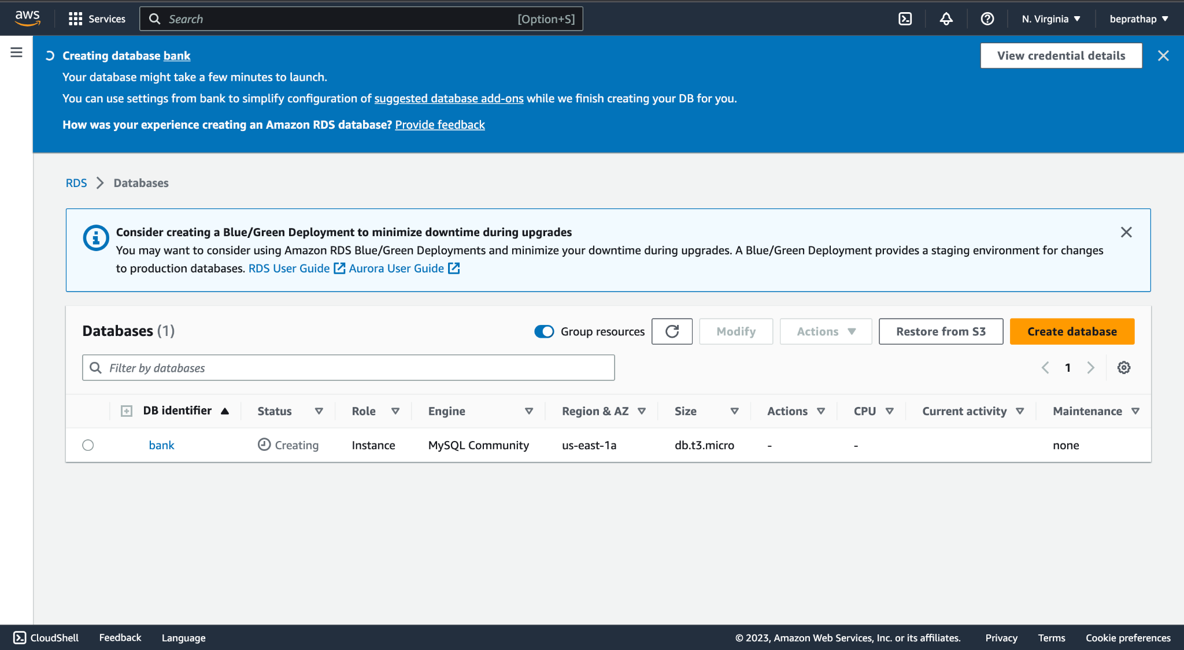
Create an Amazon RDS Instance

Slide 12
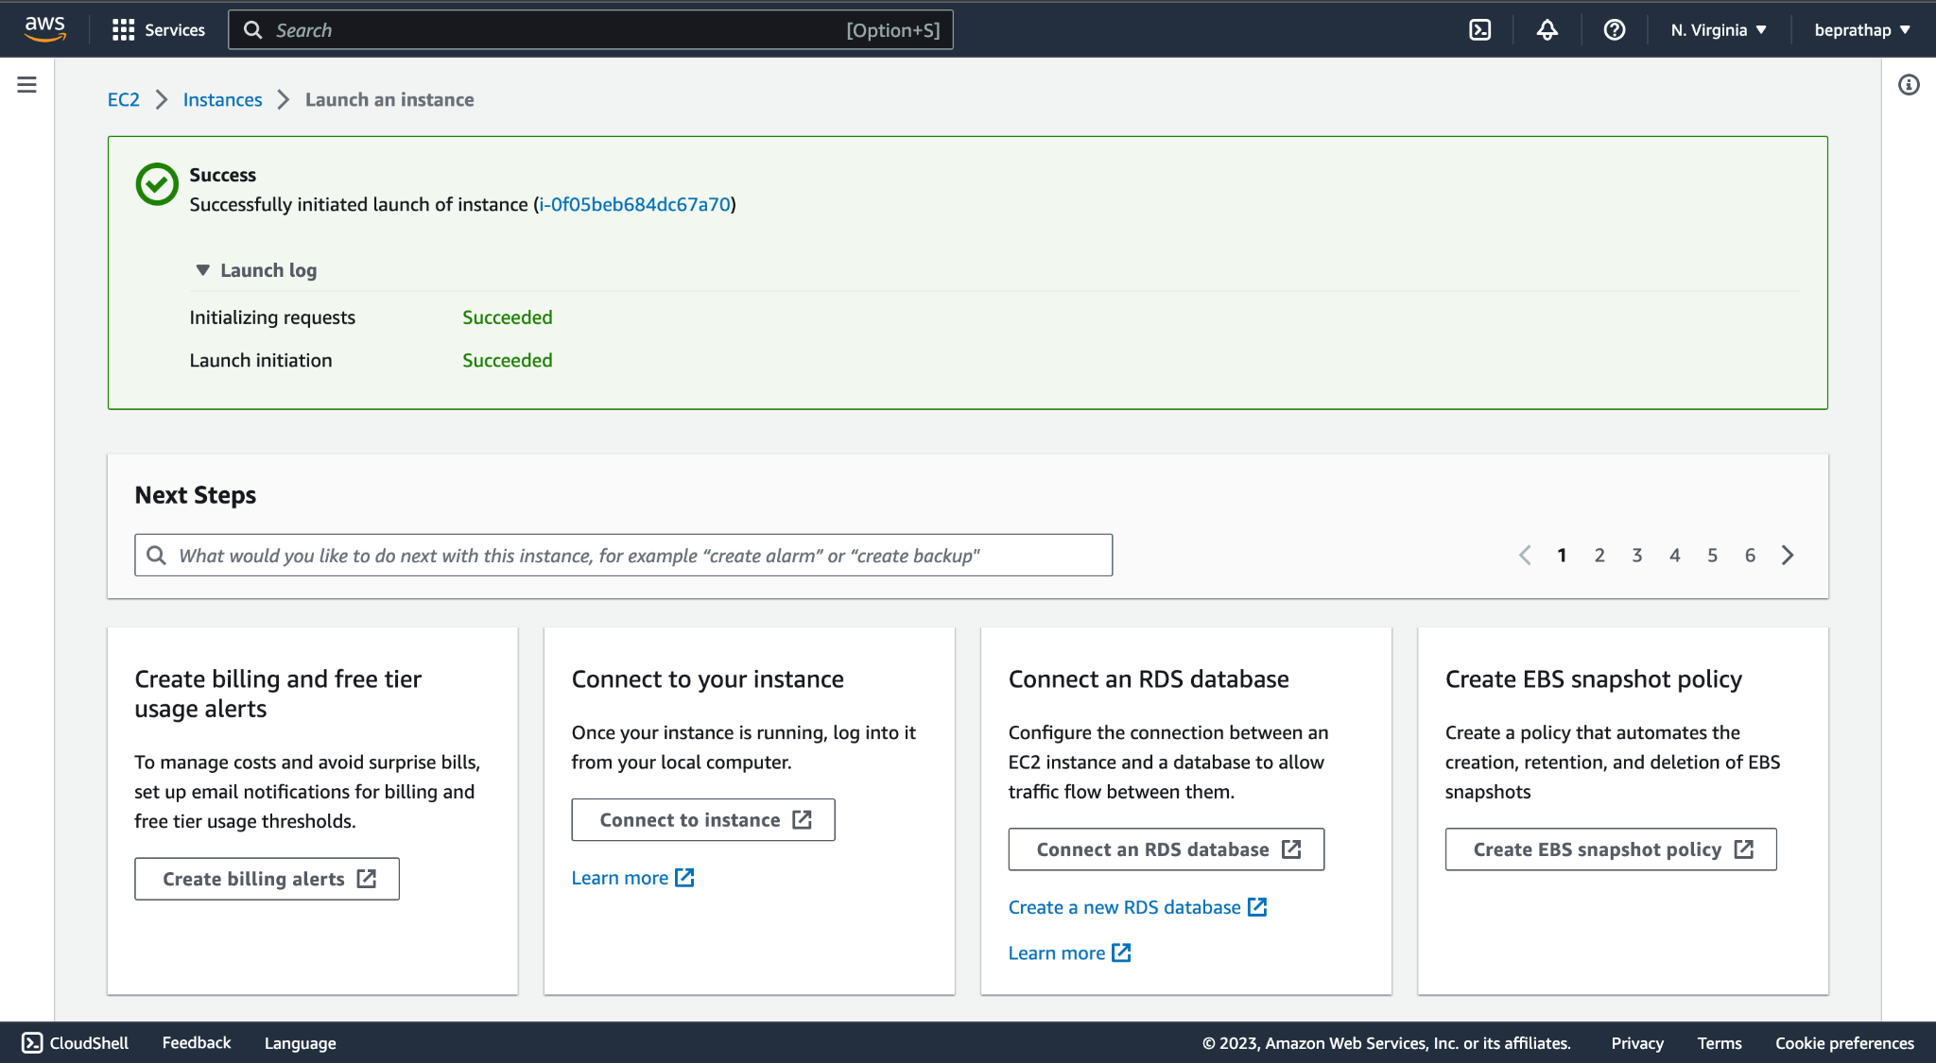
Launch an Amazon EC2 instance

Slide 13
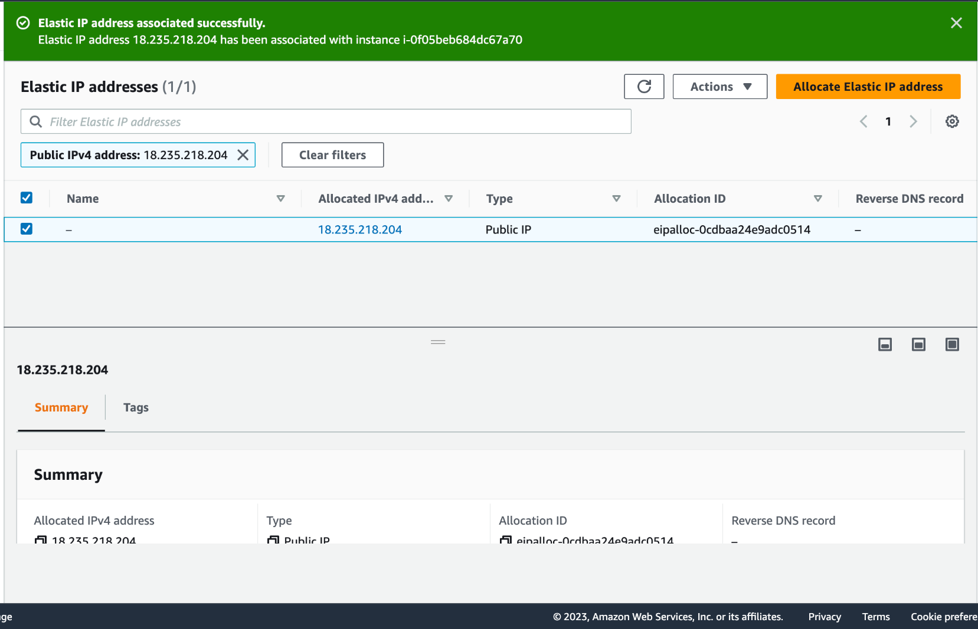
Allocate an Elastic IP

Slide 14
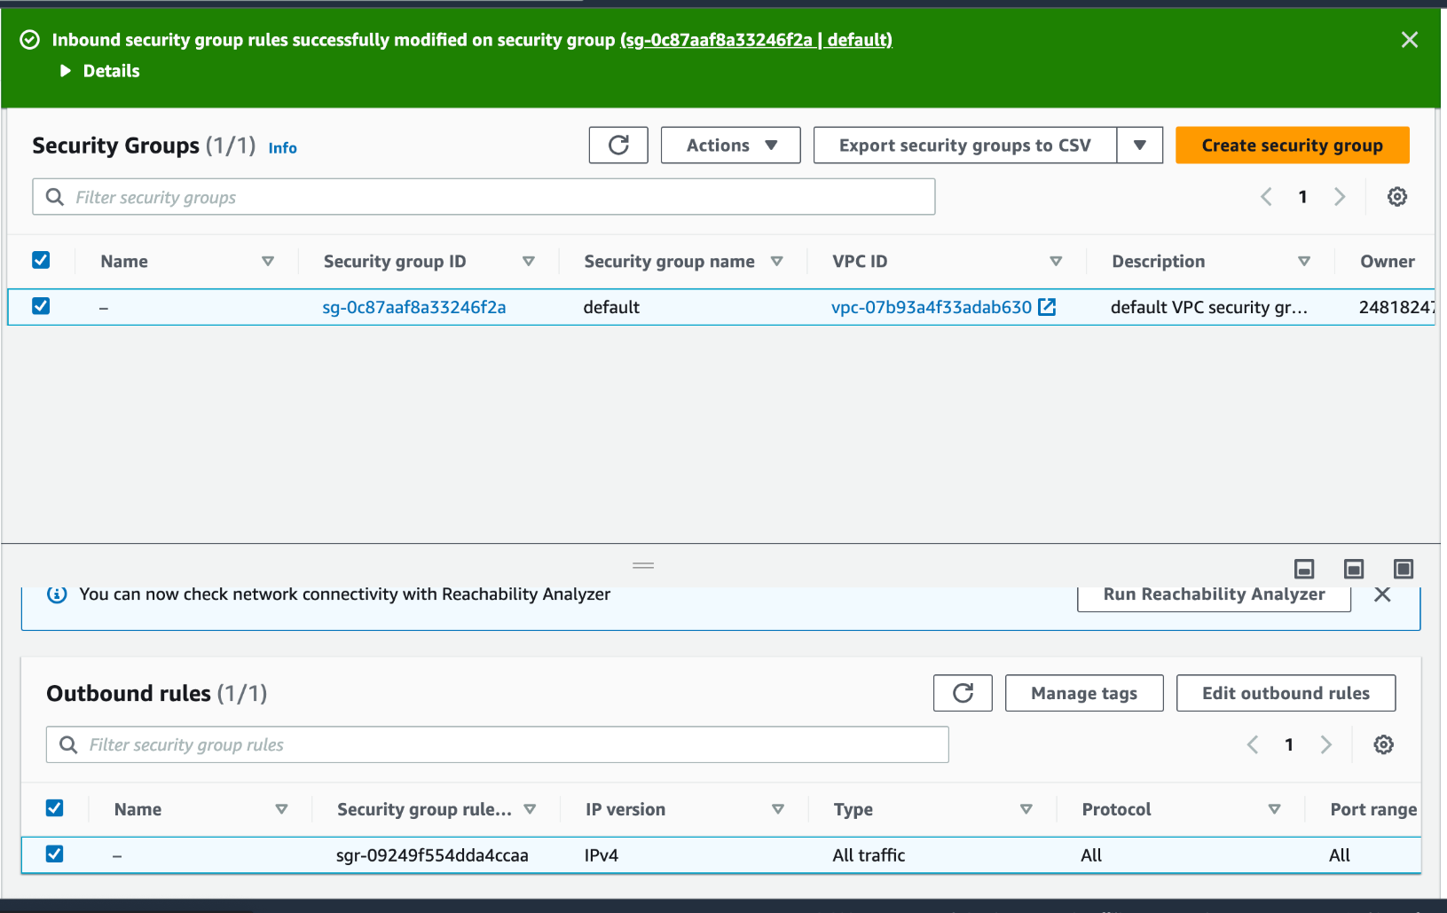
Configuring the Security Group

Slide 15


Deploy the PHP Project
Set up Database Connection

Slide 16
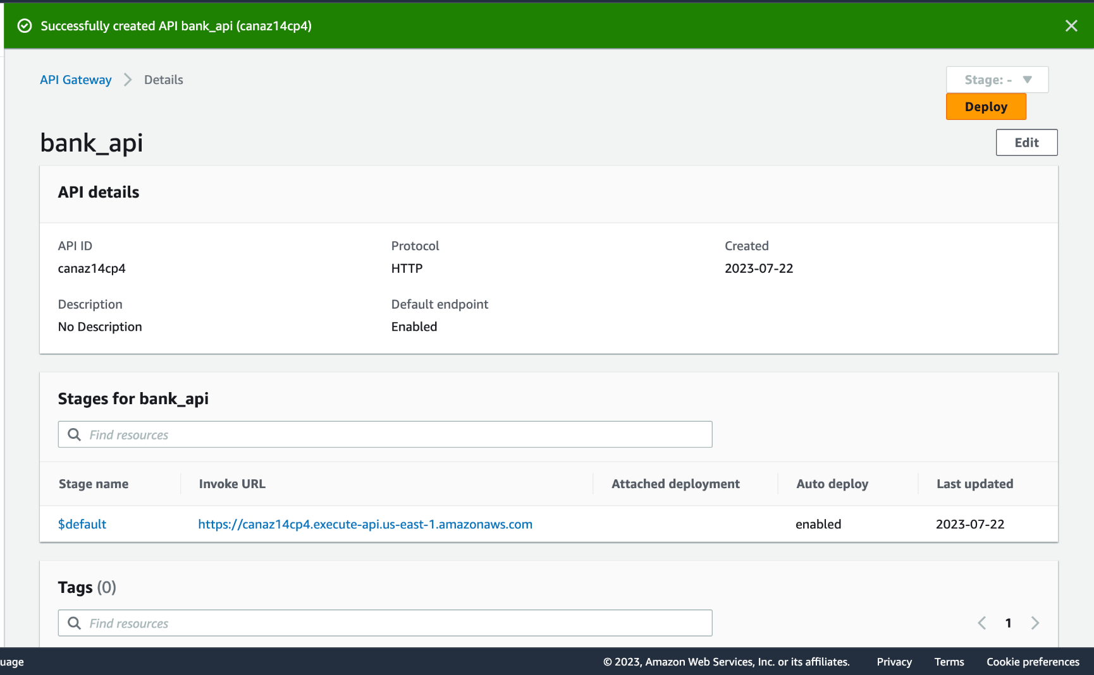
Configuring the API Gateway

Slide 17
Others
Key Learnings
Difficulties Faced
We have not only gained hands-on experience with AWS services but also deepened our understanding of cloud architecture best practices.
AWS labs helped us in the deployment of our web application using the services available on AWS.
We have faced difficulties mainly due to the lack of knowledge of cloud technologies initially and in selecting the right services for the right function.
But over the period we made use of AWS academy in understanding each service.

Slide 18

Thank you for listening!

